Slide 1
Linear Inequalities Applications

Slide 2
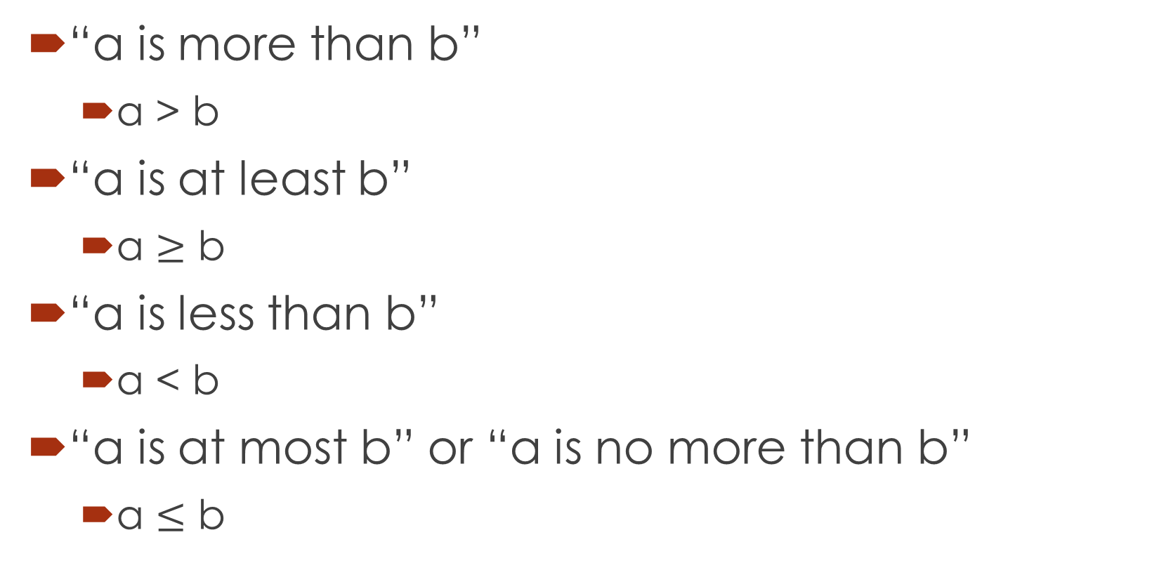
Inequalities Phrases
“a is more than b”
  a > b
“a is at least b”
  a $≥$ b
“a is less than b”
  a < b
“a is at most b” or “a is no more than b”
  a $≤$ b

Slide 3
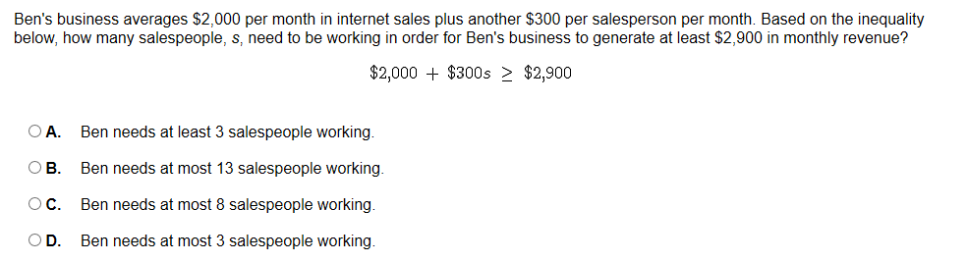
Example 1

Slide 4
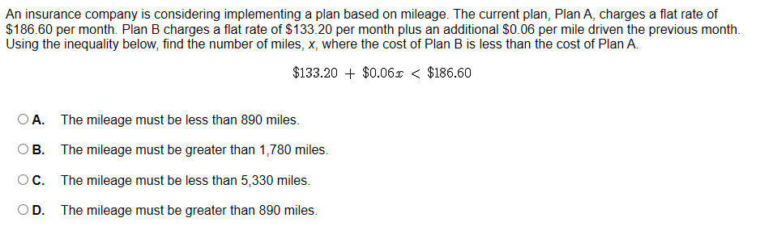
Example 2

Slide 5
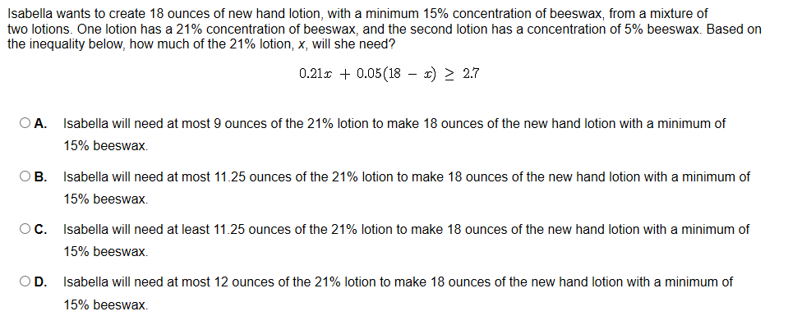
Example 3

Slide 6
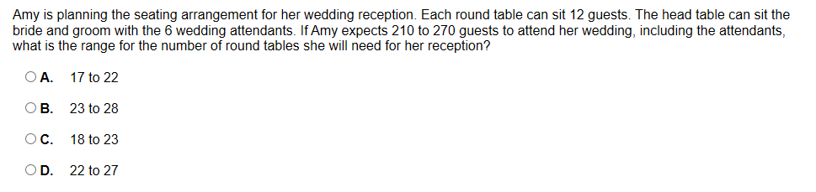
Example 4

Slide 7
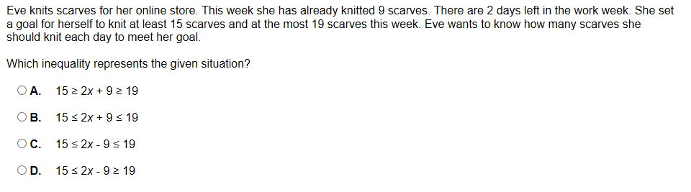
Example 5

Slide 8
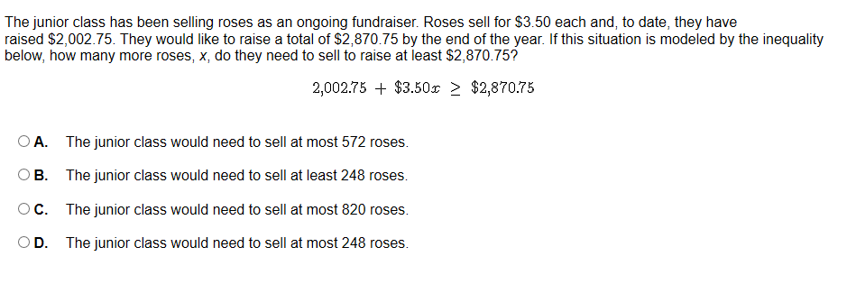
Example 6

